Slide 1
Canny Edge Detection In Verilog
Name: Po-Yu Huang
UID: 117684681

Slide 2
Recap:
1. Image processing for INVERT_OPERATION (gray scale), BRIGHTNESS_OPERATION and THRESHOLD_OPERATION.
This Presentation:
1. Implementation of Canny Edge Detection Algorithm
2. Code Structure in Verilog

Slide 3
5 steps for Canny Edge Detection Algorithm
0. Gray Scale (Did it by the paper)
Noise Reduction
Gradient Calculation (Sobel Edge Detection)
Non-maximum Suppression
Double Threshold
Edge Tracking by Hysteresis

Slide 4


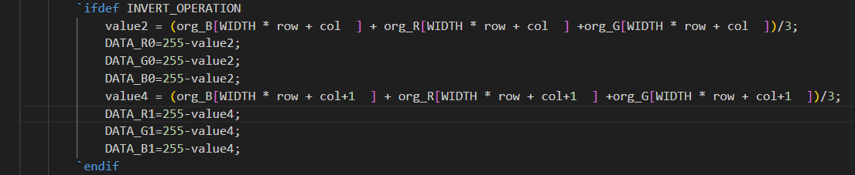
Gray Scale
Lightness Method
Average Method
Luminosity Method

Slide 5
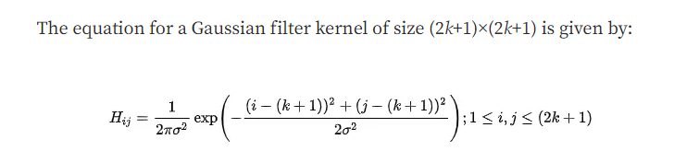
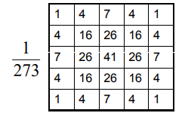
Noise Reduction (Gaussian filter)
It helps to eliminate noise from blurry images.
It is used to reduce noise from the image taken in low light.
It can eliminate the bright pixels.
It helps to make edges smooth.
Figure From non
(2023). Retrieved 9 May 2023, from https://www.cs.auckland.ac.nz/courses/compsci373s1c/PatricesLectures/Gaussian%20Filtering_1up.pdf

Slide 6
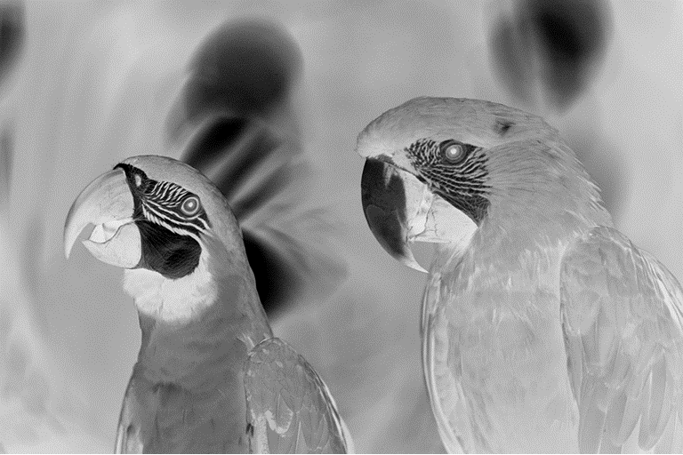

Noise Reduction (Result)
Without filter
With filter

Slide 7
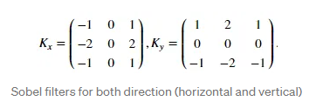
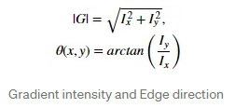
Gradient Calculation
Figure From Canny Edge Detection Step by Step in Python — Computer Vision
Notes:
C:\Users\USER\OneDrive\school work\808 VHDL testing\VLSI project\sobel_edge_detection\sobel_edge_detection.sim\sim_1\behav\xsim

Slide 8
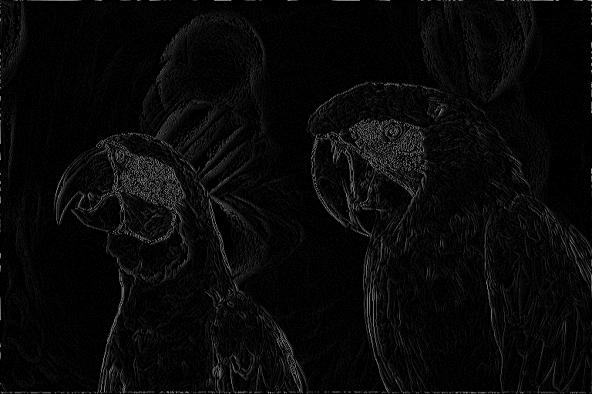
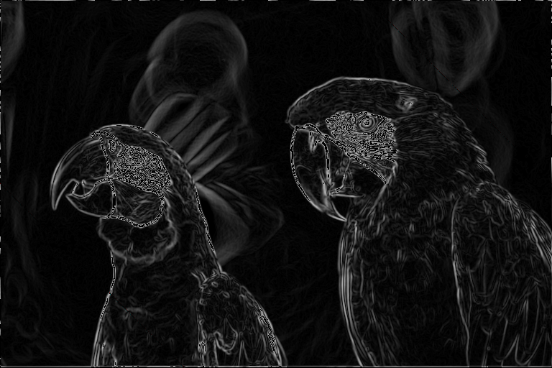
Gradient Calculation (Result)
Just getting the value from G[18:5]
Using $sqrt()

Slide 9
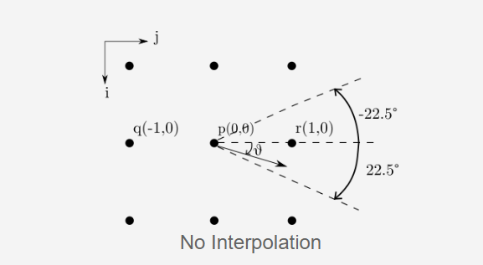
Non-maximum Suppression
Ideally, the final image should have thin edges.
Principle: The algorithm goes through all the points on the gradient intensity matrix and finds the pixels with the maximum value in the edge directions.
Divide the 3x3 grid of pixels into 8 sections.
Figure From non
(2023). Retrieved 9 May 2023, from https://www.cs.auckland.ac.nz/courses/compsci373s1c/PatricesLectures/Gaussian%20Filtering_1up.pdf

Slide 10
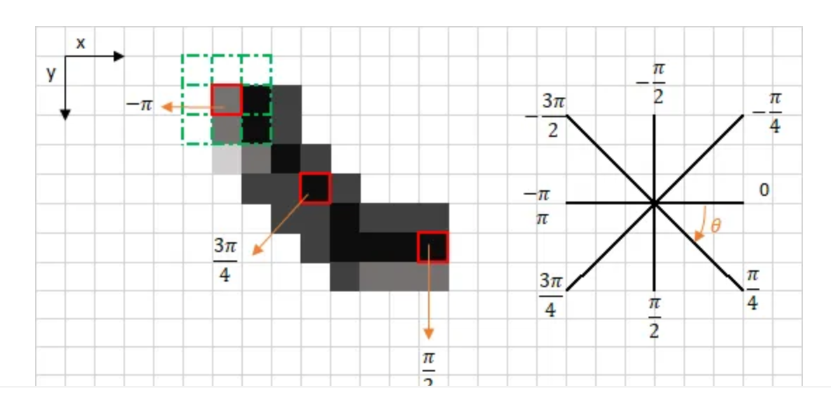
Non-maximum Suppression

Slide 11
Non-maximum Suppression (Result)

Slide 12
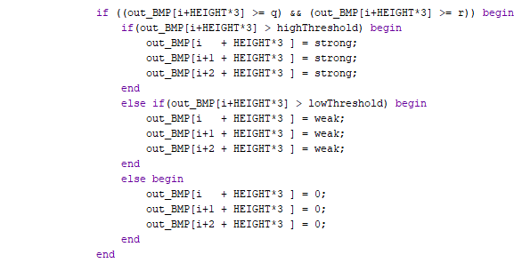

Double Threshold
The double threshold step aims at identifying 3 kinds of pixels: strong, weak, and non-relevant:

Slide 13
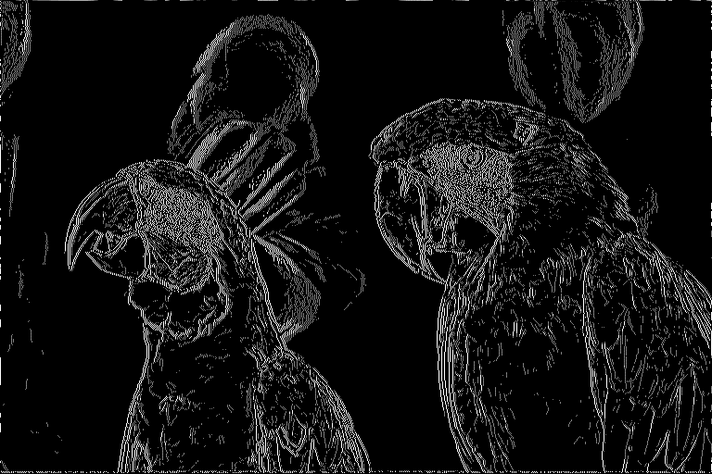
Double Threshold (Result)

Slide 14
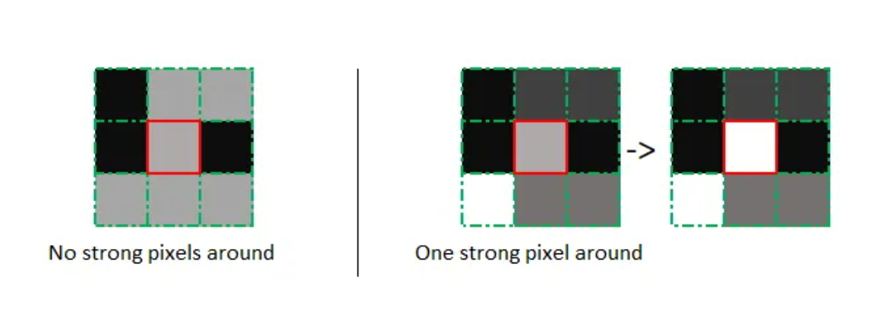
Edge Tracking by Hysteresis
Based on the threshold results, the hysteresis consists of transforming weak pixels into strong ones, if and only if at least one of the pixels around the one being processed is a strong one

Slide 15
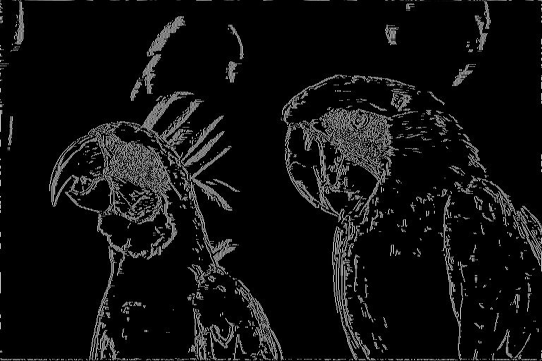
Edge Tracking by Hysteresis (Result)

Slide 16
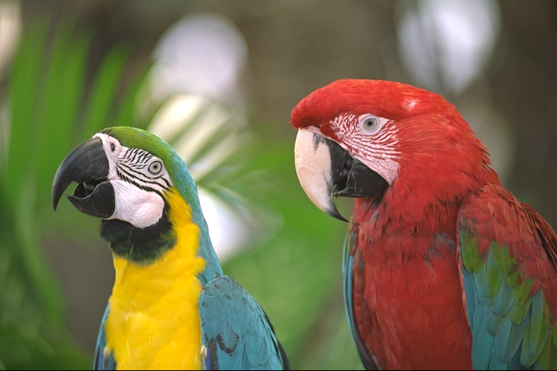
Final Result

